Slide 1
Day 04
Linux Device Driver Training
SHELL SCRIPTING
Presented by,
Ganavi M
Ganavigowda512@gmail.com

Slide 2
Secure Shell (SSH)
Securely access remote systems.
Example command: ssh username@hostname.
SSH (Secure Shell) is a protocol used to securely access remote systems over an unsecured network.
It provides encrypted communication between the client and server, preventing eavesdropping and data tampering.
Enables secure remote command execution and data transfer.
Supports both password-based and key-based authentication.

Slide 3
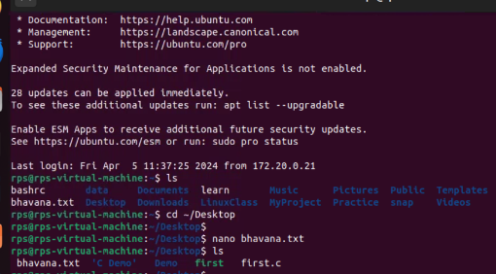
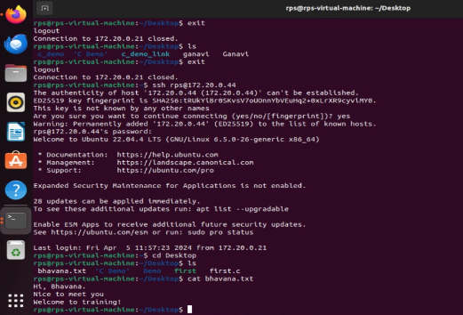
SSH
Accessed 172.20.0.44 from my system | Display of content in 172.20.0.44's system

Slide 4
Secure Copy (SCP)
Securely transfer files between local and remote systems.
Example command syntax: scp [options] source destination.
SCP (Secure Copy) is a command-line utility used to securely transfer files between local and remote systems.
It encrypts data during transmission, ensuring confidentiality and integrity.
Offers secure and efficient file transfer functionality.
Syntax: scp [options] source destination.

Slide 5
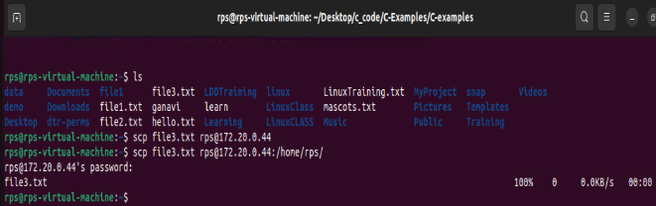
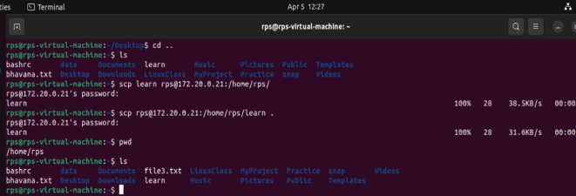
Sharing of files from two different system using ip address
Displaying of copied "file3.txt" file in 172.20.0.44

Slide 6
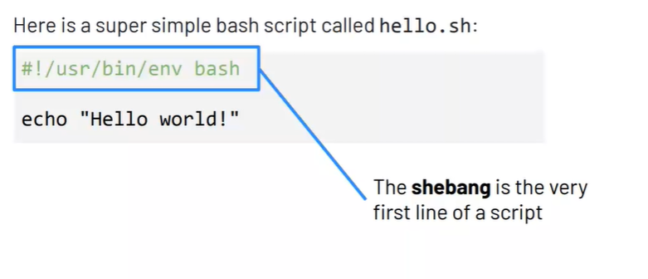
SHELL SCRIPTING
Shell scripting is the process of writing and executing scripts written in a shell language, such as Bash (Bourne Again Shell).
It allows automating repetitive tasks, executing commands, and performing various operations in Unix-like operating systems

Slide 7
SHELL SCRIPTING
Basic Structure of a Shell Script:
Shebang: Start the script with #!/bin/bash to specify the interpreter.
Comments: Use # to add comments for clarity and documentation.
Commands: Write commands to be executed in the script body.
Variables: Declare and use variables to store data values.
Syntax: variable_name=value.
Input/Output: Read input from users using read command. Display output using echo or printf commands.
Conditional Statements: Use if, elif, and else statements for conditional branching.
Syntax: if [ condition ]; then ... fi.
Loops: Use for, while, and until loops for repetitive tasks.
Syntax: for item in list; do ... done.

Slide 8
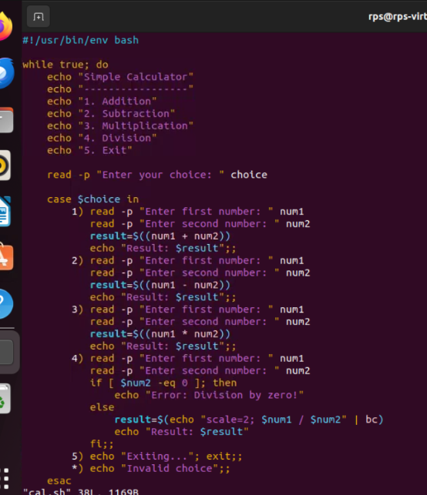
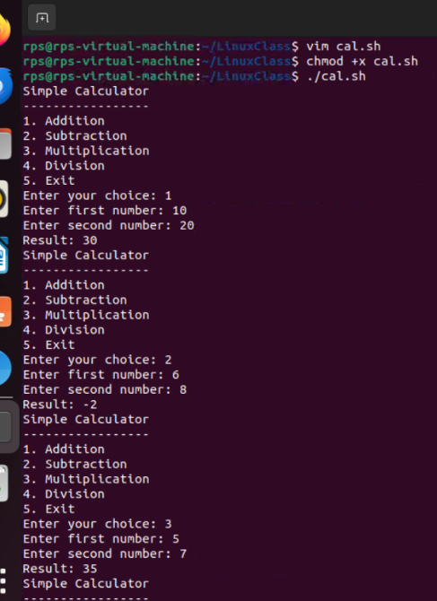
SIMPLE CALCULATOR

Slide 9
Thank you

